Slide 1
Entity Relationship Diagram
Lecturer: Salma Mamdouh
smamdouh@mcit.gov.eg
Room:3005
Made by:
Shahinaz S. Azab
Edited by:
Mona Saleh

Slide 2
Entity Relationship Modeling
Entity-Relationship Diagram (ERD): identifies information required by the business by displaying the relevant entities and the relationships between them.

Slide 3
Entity Relationship Modeling (Cont’d)
In building a data model a number of questions must be addressed:
  What entities need to be described in the model?
  What characteristics or attributes of those entities need to be recorded?
  Can an attribute or a set of attributes be identified that will uniquely identify one specific occurrence of an entity?
  What associations or relationships exist between entities?

Slide 4
Definitions
Entity - An entity is a thing in the real world with an independent existence. Physical existence (for example, a particular person, car) or conceptual existence (for instance, a job, or a university course). Types of entities: Weak- Regular
Entity Instance - An instance is a particular occurrence of an entity. For example, each person is an instance of an entity, each car is an instance of an entity, etc.
Attribute - The particular properties that describe the entity. An EMPLOYEE entity may be described by the employee’s name, age, address and salary attributes.

Slide 5
Weak Entity Types
An entity that does not have a key attribute
A weak entity must participate in an identifying relationship type with an owner or identifying entity type
Entities are identified by the combination of:
  A partial key of the weak entity type
  The particular entity they are related to in the identifying entity type
Notes:
Example:
Suppose that a DEPENDENT entity is identified by the dependent’s first name and birth date, and the specific EMPLOYEE that the dependent is related to. DEPENDENT is a weak entity type with EMPLOYEE as its identifying entity type via the identifying relationship type DEPENDENT_OF

Slide 6
Types of Attributes
Key: an attribute whose values are distinct (unique) for each entity and can be used to uniquely identify the record
Multi-valued: has a set of values for the same entity instance
Composite: can be divided into smaller subparts
Derived: can be calculated from another attribute or entity
Single/Simple: Attributes that are not divisible and have a single value for a particular entity instance

Slide 7
Key Attribute
Single Key: For example, SSN of EMPLOYEE
Composite Key: the combination of the attribute values that together form a key and must be distinct for each entity. For example, ID and Application_no
Candidate Key: when an entity type has more than one key, those are candidate keys
Notes:
If two attributes are underlined separately, then each is a key on its own
There is no concept of primary key in the ER model, the primary key will be chosen during mapping
An entity type may also have no key, in which case it is called a weak entity type

Slide 8
Relationships
Relationships - A relationship is a connection between entity classes.
  Degree of a Relationship: is the number of participating entity
  Cardinality Ratio: specifies the maximum number of relationship
  Participation: specifies the minimum number of relationship instances that each entity can participate with.
Notes:
Relationship: Establishes a connection or correspondence or link between a pair of tables in a database, or between a pair of entities in an entity-relationship diagram (ERD).
One-to-one relationship: A single record in table A is related to only one record in table B, and vice versa.
One-to-many relationship: A single record in table A can be related to one or more records in table B, but a single record in table B can be related to only one record in table A.
Many-to-many relationship: A single record in table A can be related to one or more records in table B, and vice versa. Problems with many-to-many relationships: one of the tables will contain a large amount of redundant data, both tables will contain some duplicate data, it will be difficult to add, update, delete records because of the duplication of fields between tables.

Slide 9
Relationships (cont.)
  Degree of a Relationship
    Unary/ Recursive
    Binary
    Ternary
lead
Emp
Emp
work
Dept
supply
Supplier
Part
Project

Slide 10
Relationships (cont.)
  Cardinality Ratio
    One to one
    One to many
    Many to many
1
manage
1
Emp
Dept
M
work
1
Emp
Dept
Emp
M
work
N
Proj

Slide 11
Relationships (cont.)
  Participation
    Total/ Full Dependency/ Mandatory
    Partial/ Partial Dependency/ Optional
1
manage
1
Emp
Dept
Partial
Total

Slide 12

Participation Example
Has
Employee
Car
An Employee may have a car.
A Car must be assigned to particular employee

Slide 13
Participation Example
Hire
Department
Employee
- A department may hire many employees ( Zero or more)
An employee must be employed by a department
(Department membership is Optional, Employee membership is Mandatory)
Notes:
A formal constraint: (min,max) where m, n are min and max number of times an entity participates in a relationship instance. For example, (0,10) means partial participation, and (1,max) means total participation.

Slide 14
ERD Notations
Rectangles represent ENTITY CLASSES
Circles represent ATTRIBUTES
Diamonds represent RELATIONSHIPS
Arcs - Arcs connect entities to relationships. Arcs are also used to connect attributes to entities. Some styles of entity-relationship diagrams use arrows and double arrows to indicate the one and the many in relationships. Some use forks etc.
Underline - Key attributes of entities are underlined.

Slide 15
SUMMARY OF ERD NOTATION
Symbol
Meaning
ENTITY TYPE
WEAK ENTITY TYPE
RELATIONSHIP TYPE
IDENTIFYING RELATIONSHIP TYPE
ATTRIBUTE
KEY ATTRIBUTE
MULTIVALUED ATTRIBUTE
COMPOSITE ATTRIBUTE
DERIVED ATTRIBUTE
TOTAL PARTICIPATION OF E₂ IN R
CARDINALITY RATIO 1:N FOR E₁:E₂ IN R
STRUCTURAL CONSTRAINT (min, max) ON PARTICIPATION OF E IN R
E₁
R
E₂
E₁
R
N
E₂
R
(min,max)
E
Notes:
Guidelines:
• The existence of a relationship between two entities is drawn as a line connecting the entities.
• Arrows at the ends of the lines indicate different types of relationships (one-to-one, one-to-many, many-to-many)
• Verbs may be placed on the relationship lines that describe what the relationships mean (e.g. “addresses locate businesses”, where “addresses” and “businesses” are related entities, and “locate” is
the verb describing the relationship.)
• Lists of attributes are developed as you go. (An attribute is a single piece of information that is descriptive of an entity, e.g. friend name, friend e-mail.)
• A single attribute for each entity is selected (or an arbitrary one is assigned) as being the unique identifier for each occurrence of the entity (e.g. business id number to uniquely identify a business).

Slide 16
An Example
A company is organized into departments. Each department has a unique name, a unique number, and a particular employee who manages the department. A department may have several locations.
A department may control a number of projects, each of which has a unique name, a unique number, and a single location. A project must be controlled by department

Slide 17
An Example (Cont’d)
We store employee’s name, social security number, address, salary, gender and birth date. An employee must be assigned to one department and must work on one or more projects, which are not necessarily controlled by the same department. We keep track of the number of hours per week that an employee works on each project. We also keep track of the direct supervisor of each employee.
We want to keep track of the dependents of each employee for insurance purposes. We keep each dependent’s first name, gender, birth date and relationship to that employee.

Slide 18
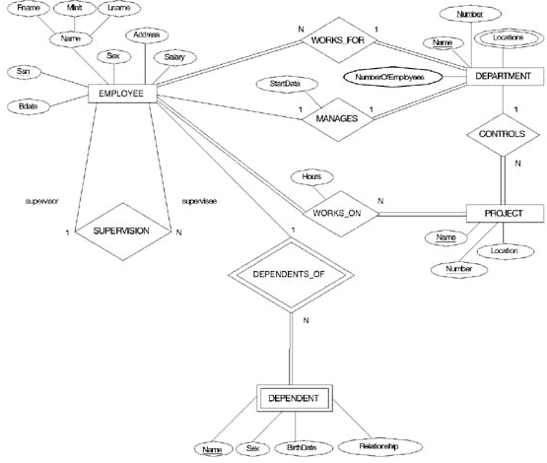

Slide 19
ERD Case Study
An organization makes many models of cars, where a model is characterized by a unique name and a suffix (such as GL or XL) and an engine size.
Each model is made up from many parts and Each part has a description , an id code, production year, and many images.
each part may be used in the manufacturing of more than one model

Slide 20
ERD Case Study
Each model must be produced at just one of the firm's factories, which are located in London, Birmingham, Bristol, Wolverhampton and Manchester - one in each city. Each factory has number of machines, capacity, and computer system used ( OS , DBMS, Internet).
A factory produces many models of cars and many types of parts.
Notes:
although each type of part is produced at one factory only and the model is produced in the same factory.

